Slide 1
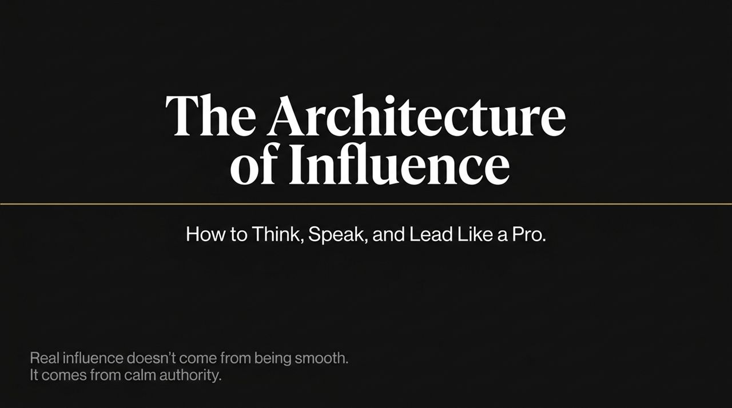
Notes:
Welcome everyone. Today we are diving into a subject that quietly dictates career growth, leadership effectiveness, and personal presence: The Architecture of Influence.
There is a fundamental truth that most professionals avoid facing: If people do not feel clarity, strength, and certainty in your voice, they will not trust you, they will not follow you, and they will not take action because of you. You can possess brilliant ideas, deep technical expertise, and years of experience, but if your delivery fails to reflect that internal value, the world will never recognize your full potential.
Most people operate under the misconception that communication is about being 'smooth' or performing with artificial charisma. But real influence isn't theatrical—it stems from calm authority. It comes from organized thinking, precise word selection, and mastering your physiological pacing—knowing exactly when to speak and when to hold silence. Over the next section of this deck, we are going to unpack how to transition from reactive talking to intentional leadership.
How to Think, Speak, and Influence Like a Pro | Best Audiobooks
https://www.youtube.com/watch?v=EScIzEExWWE

Slide 2
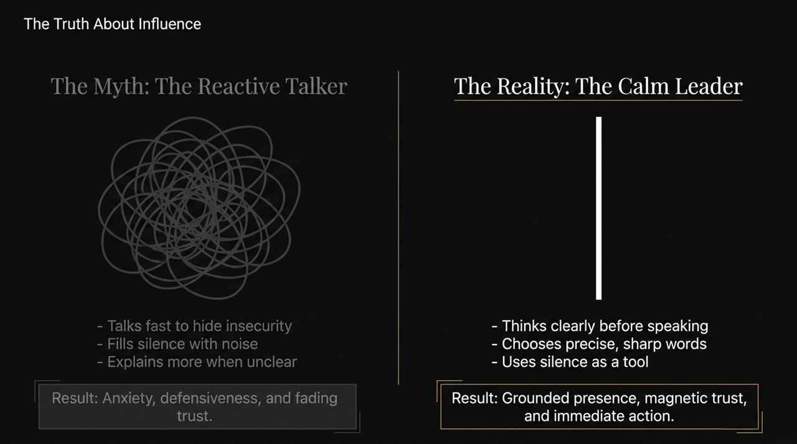
Notes:
Take a moment to look at this image. It represents what happens inside the mind of an uncalibrated communicator.
Many professionals fall into an exhausting cycle: they begin talking before their thoughts are fully formed. Because they weren't clear from the start, they over-explain. Because they sense the room slipping away, they add even more words, hoping that sheer volume or speed will bridge the gap. This mental tangle isn't an intelligence issue; it's a structural issue. The human brain is simply not wired to filter, organize, refine, and articulate complex ideas simultaneously in real-time.
When your mental 'desk' looks like this scribbled mess, your spoken output becomes equally foggy. Before we can expect an audience to follow our direction, we must settle the internal noise and extract the single signal that matters.

Slide 3
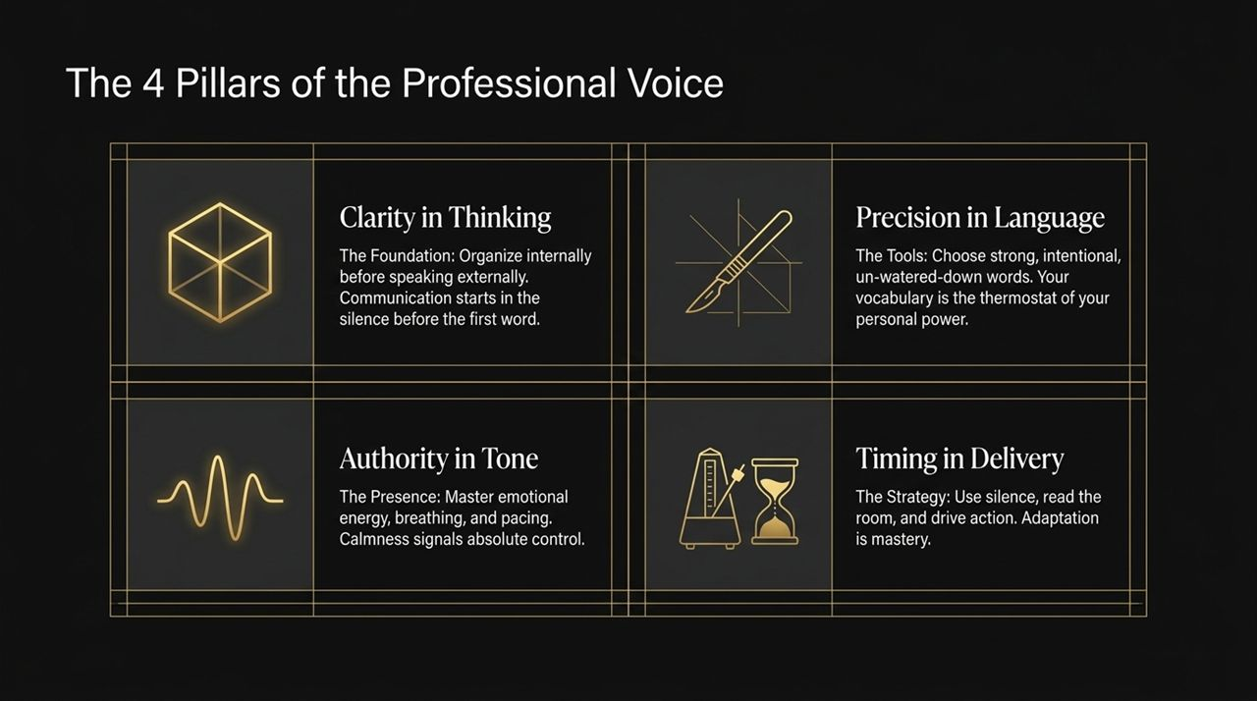
Notes:
Let's contrast the two types of communicators you encounter in every meeting, negotiation, or board room.
On the left, we have The Reactive Talker. This person speaks fast to mask underlying insecurity. They view silence as awkward or dangerous, so they fill every micro-second with filler words or extra detail. When challenged or misunderstood, their instinct is to explain more and louder. The result? The audience experiences anxiety, senses defensiveness, and trust gradually fades.
On the right is The Calm Leader. The Calm Leader understands that communication begins in the silence before the first word is uttered. They process internally, select sharp, un-watered-down words, and use silence intentionally as a structural tool. The result is a grounded presence, magnetic trust, and immediate alignment from listeners.
Our objective today is to systematically dismantle 'reactive talking' and install the habits of the calm leader.

Slide 4
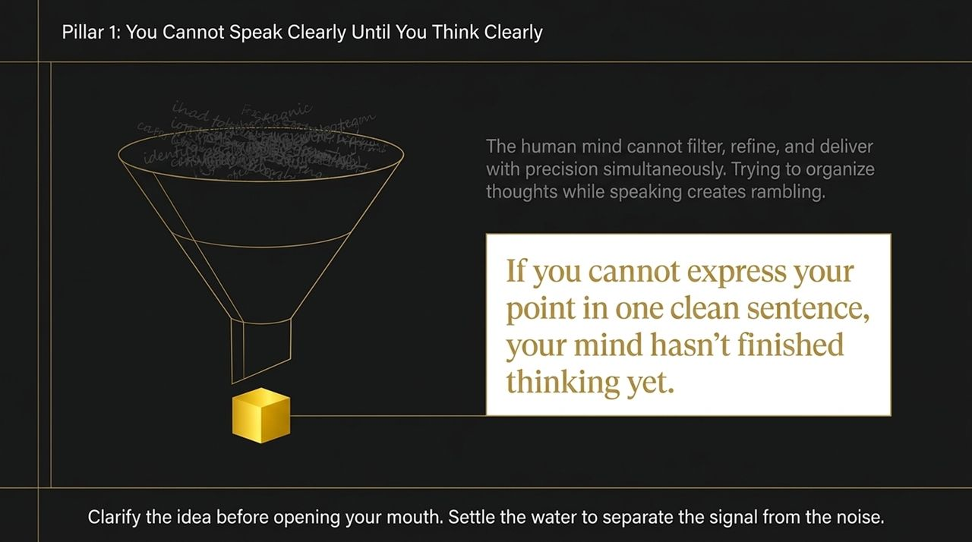
Notes:
To build a powerful professional voice, we rely on a multi-pillar foundation. These two symbols represent the first two pillars of our framework.
The Cube represents Clarity in Thinking. It symbolizes structure, solid geometry, and internal organization. It’s the discipline of building a solid framework inside your mind before you build an argument out loud.
The Scalpel represents Precision in Language. Words are not just decor; they are operational tools. A dull blade leaves ragged, messy cuts, while a sharp scalpel performs precise work with minimal effort. In communication, sharp, intentional vocabulary cuts through confusion instantly.

Slide 5
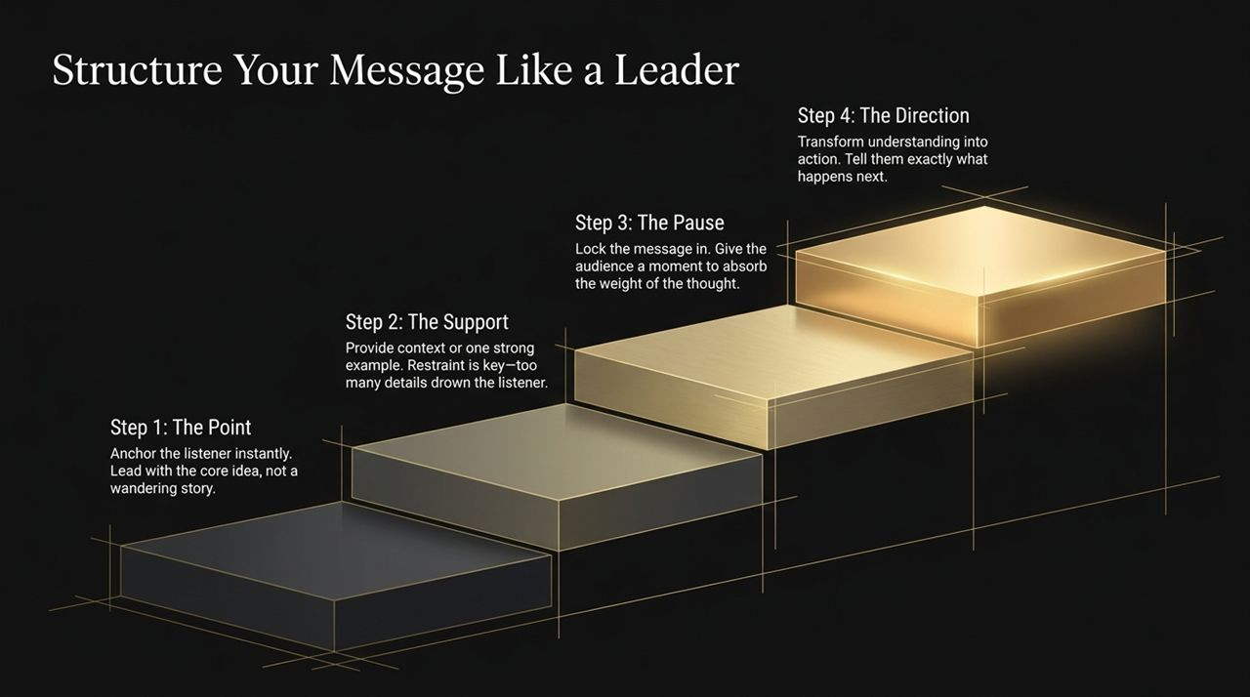
Notes:
Continuing our framework, these two symbols represent our third and fourth pillars.
The Metronome signifies Authority in Tone. It reflects rhythm, steady breathing, and emotional equilibrium. Your voice acts as a direct broadcast of your nervous system. If your tempo is erratic, the audience feels your internal tension. A metronome-like steadiness signals absolute self-control.
The Hourglass represents Timing in Delivery and the Strategic Use of Silence. Hourglasses remind us that time and silence flow with purpose. It's about knowing how to pause, reading the emotional temperature of the room, and landing your message at the exact moment it carries maximum impact.

Slide 6
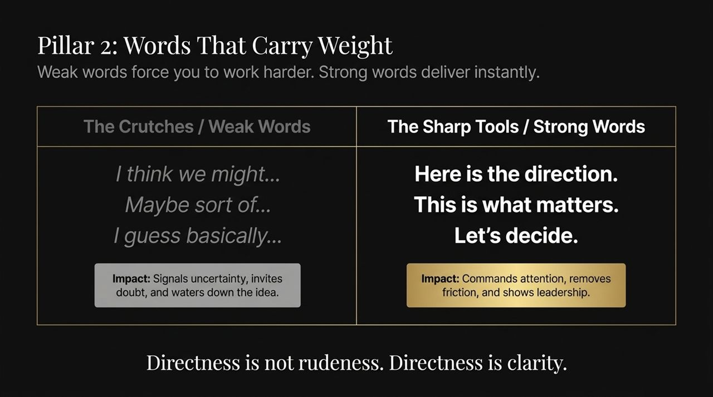
Notes:
Here is our complete blueprint: The 4 Pillars of the Professional Voice.
Clarity in Thinking (The Foundation): Organize your message internally before speaking externally. Remember, real communication starts in the silence before you open your mouth.
Precision in Language (The Tools): Eliminate fluff. Your vocabulary acts as the thermostat of your personal authority—if you use watered-down words, you lower your perceived power.
Authority in Tone (The Presence): Control your breath, lower your pitch, and regulate your cadence. Calmness signals to the room that you are in total command.
Timing in Delivery (The Strategy): Master the pause, adapt to the room's energy, and lead people toward action.
When all four pillars align, your message becomes undeniable. If even one pillar is missing, your words lose weight immediately.

Slide 7
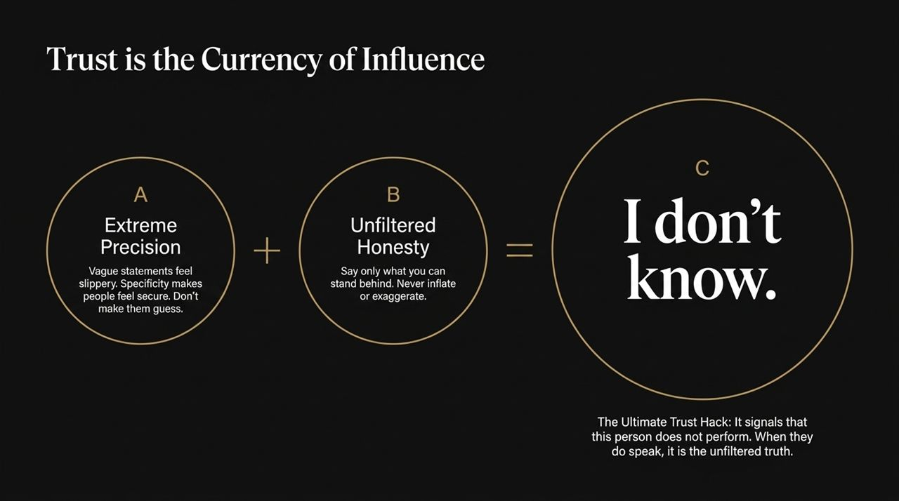
Notes:
Let's examine Pillar 1 in detail.
As we established, trying to organize thoughts while actively speaking causes rambling and over-explaining. To fix this, you must apply a benchmark rule: If you cannot express your core point in one clean sentence, your mind hasn't finished thinking yet.
Think of your ideas like murky water. When water is constantly stirred up by panic or speed, it stays cloudy. When you pause and let it settle, the mud sinks to the bottom, leaving crystal-clear water.
When asked a tough question in a meeting, resist the urge to fill the air instantly. Take a breath, let the water settle, isolate the core message in one clean sentence, and then deliver it from that centered clarity.

Slide 8
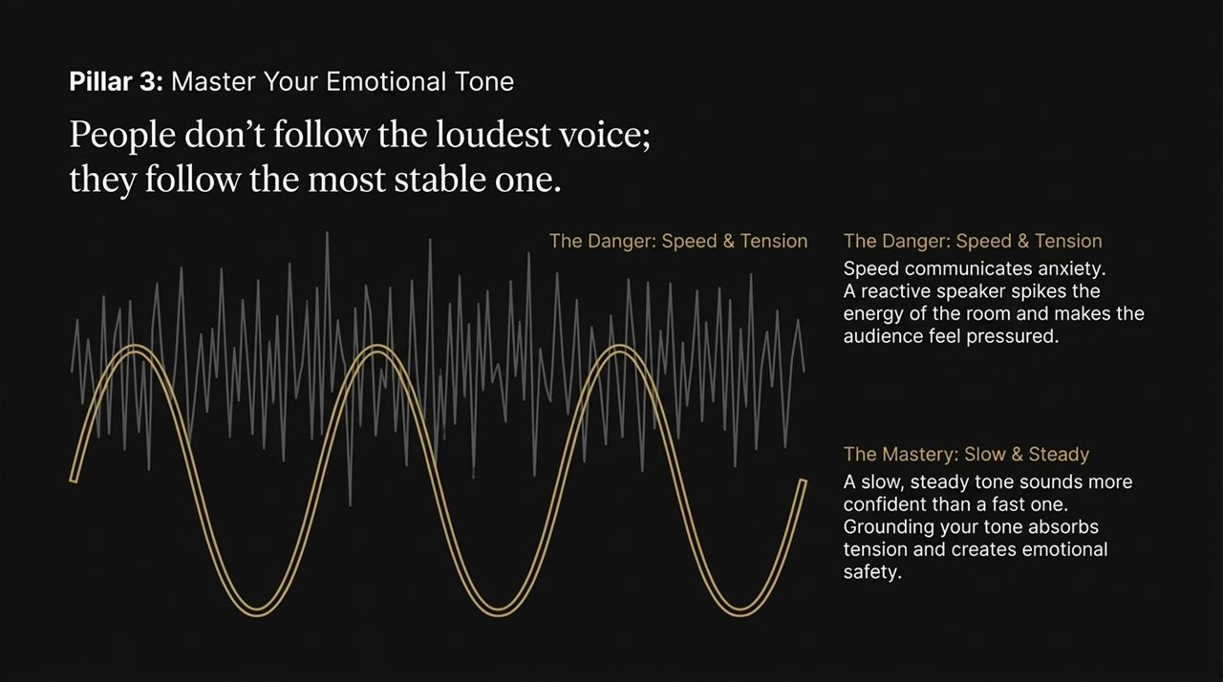
Notes:
When you speak, do not take your listener on a meandering trail; give them a clear roadmap. Use this 4-Step Message Spine:
Step 1: The Point: Anchor the audience immediately. Lead with your core idea right away rather than building up with a long backstory.
Step 2: The Support: Provide one strong example or key context piece. Restraint is crucial here—loading on too many details overwhelms the listener and dilutes the thesis.
Step 3: The Pause: Once the point and support are delivered, stop speaking for 1 to 2 seconds. This lets the weight of your thought sink in.
Step 4: The Direction: Move understanding into concrete momentum. State clearly what happens next or what action needs to be taken.

Slide 9
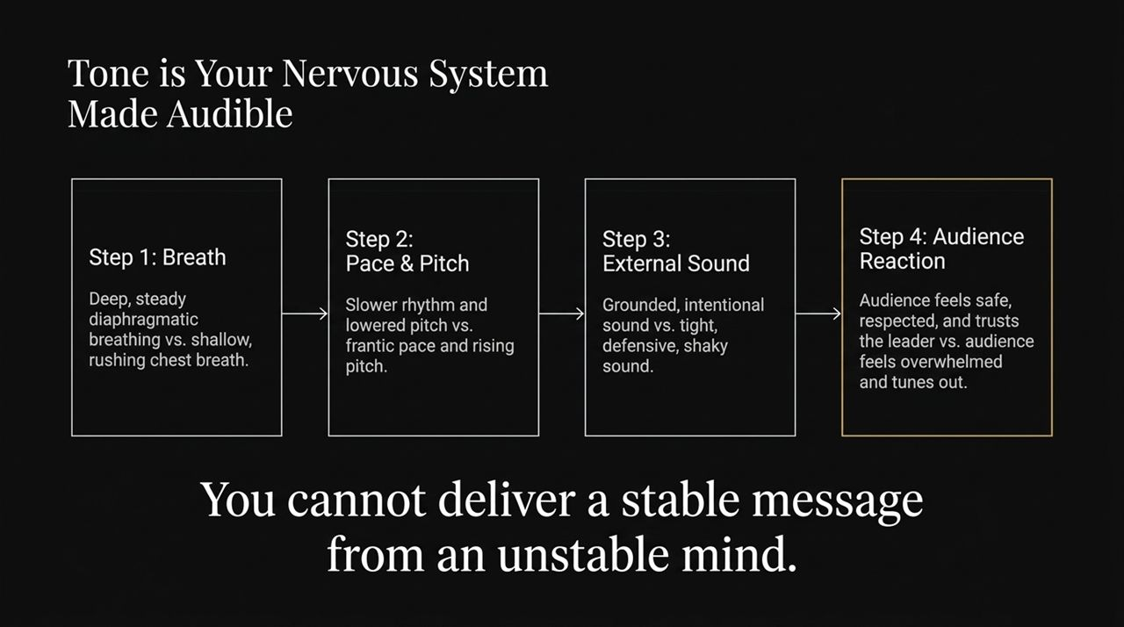
Notes:
Moving to Pillar 2, let's audit our day-to-day vocabulary. Soft, hedged words force you to work twice as hard to build credibility.
Look at the Weak Crutches on the left: 'I think we might...', 'Maybe sort of...', 'I guess basically...'. These phrases leak hesitation, invite pushback, and signal that you are second-guessing yourself.
Now examine the Sharp Tools on the right: 'Here is the direction.', 'This is what matters.', 'Let's decide.'.
Directness is not aggressiveness; directness is clarity. When you strip away filler words and state your intent cleanly, you lower cognitive friction for the listener and naturally step into a position of leadership.

Slide 10
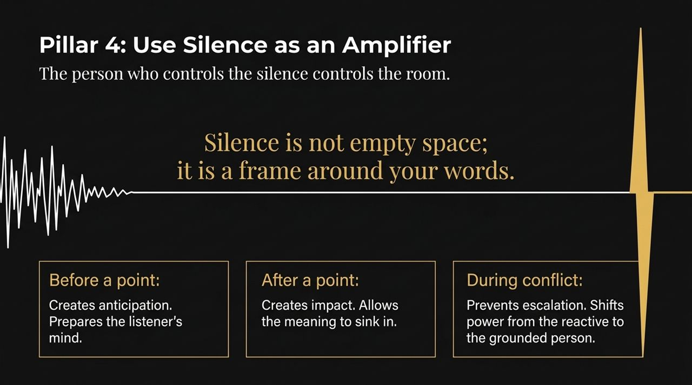
Notes:
Without trust, no amount of vocal technique or executive presence will move an audience. Trust is built through three key behaviors outlined here:
A. Extreme Precision: Vagueness makes people uncomfortable and defensive. Specificity makes people feel secure because they know exactly where things stand.
B. Unfiltered Honesty: Only say what you can stand behind. Never exaggerate metrics or inflate claims to sound impressive. People detect exaggeration quickly, and once credibility cracks, it's hard to repair.
C. The Ultimate Trust Hack—I don't know: Saying 'I don't know' demonstrates that you don't perform or pretend. When you freely admit what you don't know, people place far greater trust in the things you do state as fact.

Slide 11
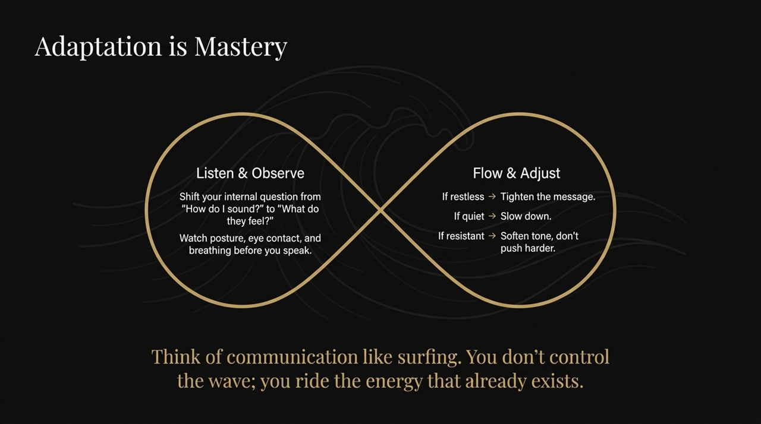
Notes:
Visualizing the physics of sound helps illustrate how tension impacts an audience.
Look at the erratic grey waveform at the top. That represents high speed and vocal tension. When a speaker is anxious, their vocal cords tighten, their pitch rises, and their speed accelerates. This erratic wave transmits anxiety straight into the room, causing listeners to feel pressured or tune out entirely.
Contrast that with the smooth, gold sine wave running underneath. That represents a slow, steady, grounded delivery. A controlled, low-frequency tone absorbs tension in high-stakes environments and creates emotional stability for everyone listening.

Slide 12
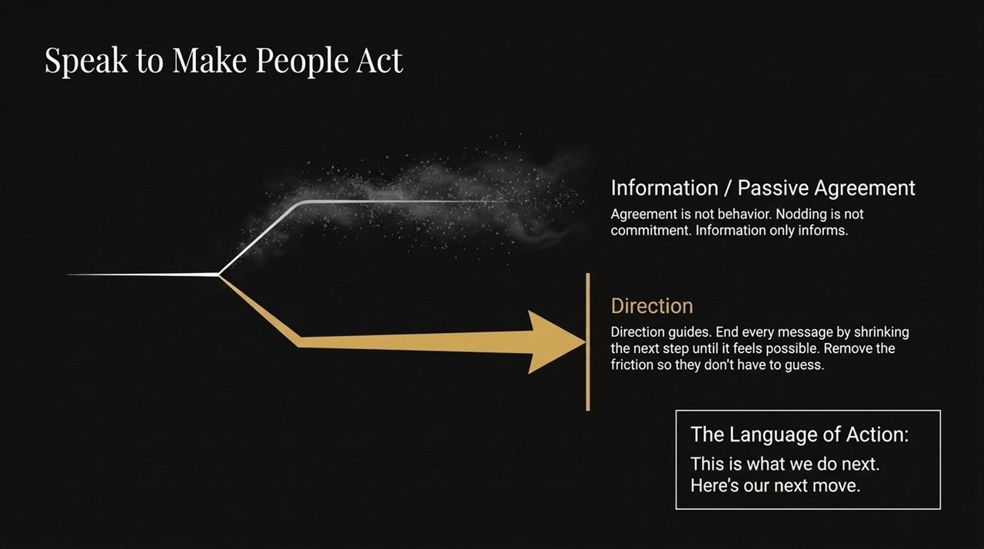
Notes:
Under Pillar 3, we recognize that your voice is your nervous system made audible. You cannot deliver a stable message from an unstable physiological state.
Let's trace the physical chain reaction:
Breath: Shallow chest breathing leads to thin, shaky delivery. Deep, diaphragmatic breathing creates a grounded, resonant voice.
Pace & Pitch: High stress causes frantic pacing and rising pitch. Intentional grounding lowers pitch and slows the cadence.
External Sound: Unchecked tension creates defensive, tight speech. Mastered physiology yields steady, intentional resonance.
Audience Reaction: A tense delivery causes the audience to disengage, whereas a calm tone makes them feel safe and receptive.

Slide 13
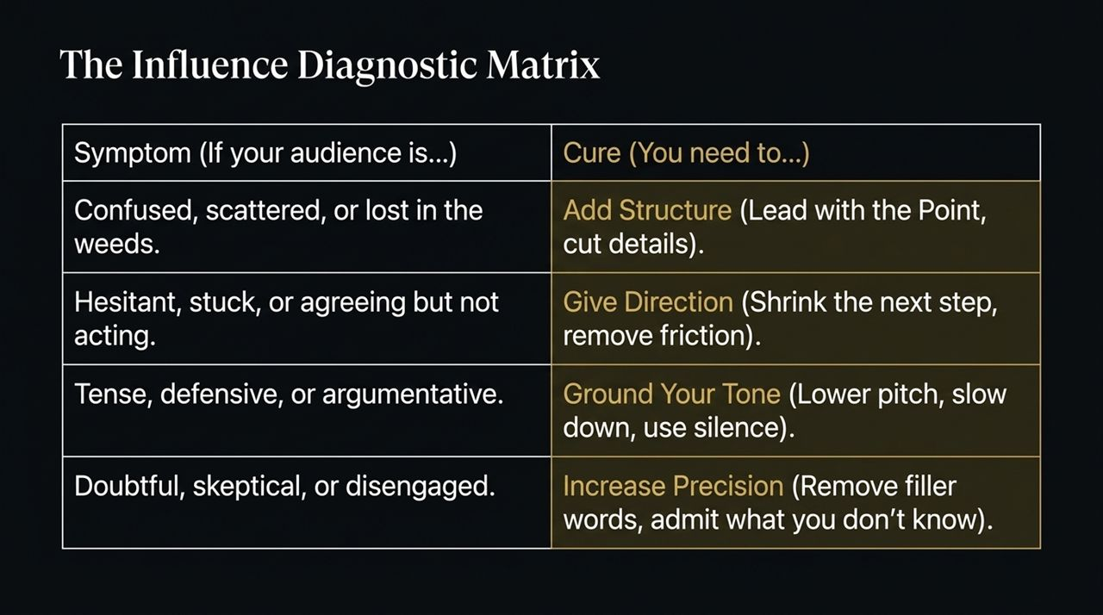
Notes:
Now let's explore Pillar 4: the strategic application of silence. Most people treat silence as an awkward gap that needs filling, but strong leaders recognize that the person who controls the silence controls the room.
Silence acts like a visual frame placed around a picture:
Before a point: A pause creates anticipation and focuses the room's attention.
After a point: A pause provides gravity, letting a critical statement sink in.
During conflict: Staying silent when tension spikes prevents emotional escalation. It shifts power away from the reactive party and anchors it with the grounded speaker.

Slide 14
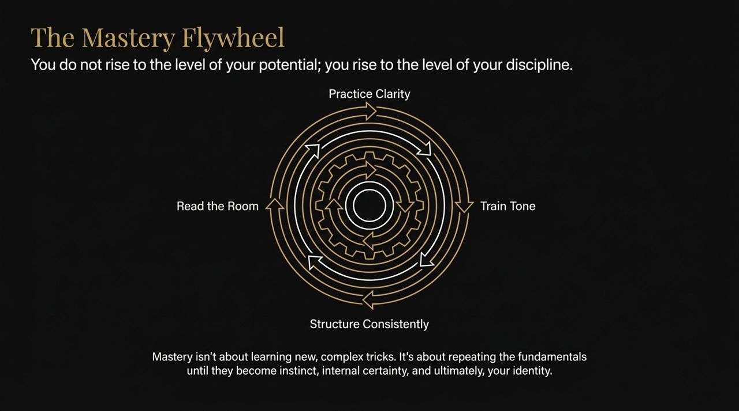
Notes:
Delivering a great speech isn't enough if it's completely disconnected from the audience's current energy. True influence requires real-time adaptation.
Shift your internal question from 'How do I sound?' to 'What are they feeling?'. Before speaking, observe body language, breathing patterns, and eye contact.
Apply these real-time adjustments:
If the audience seems restless → Tighten your message and cut minor details.
If the room is quiet or unengaged → Slow down your pace to let ideas register.
If you encounter resistance → Soften your tone rather than pushing harder.
Think of communication like surfing: you don't fight the wave; you ride the energy that already exists in the room.

Slide 15
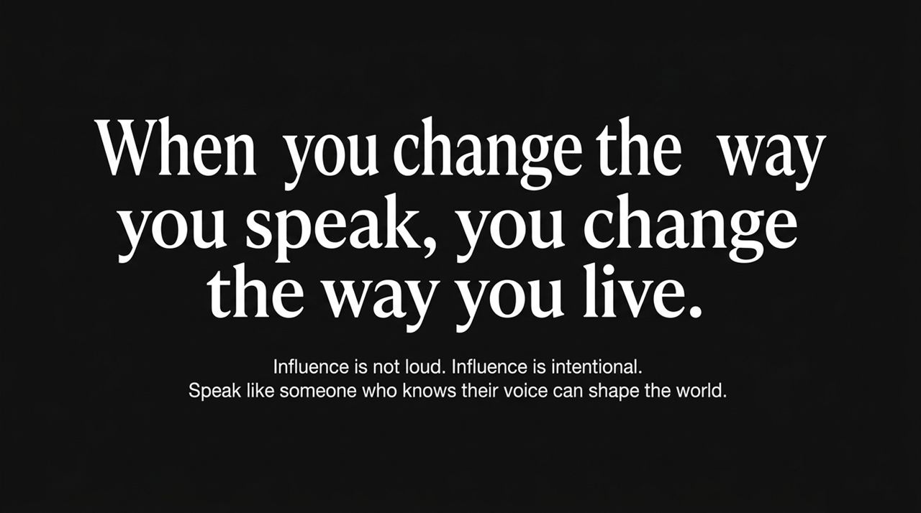
Notes:
This diagram illustrates the divergence between passive communication and strategic direction.
The top line represents passing along information for passive agreement. Head nods and polite agreement do not equal actual commitment. Simply sharing facts rarely changes behavior.
The lower gold arrow represents Directional Leadership. To drive real progress, end your points by shrinking the next step until action feels effortless. Use decisive language such as: 'This is what we do next' or 'Here is our next move.' Guidance removes ambiguity so people can act with confidence.

Slide 16
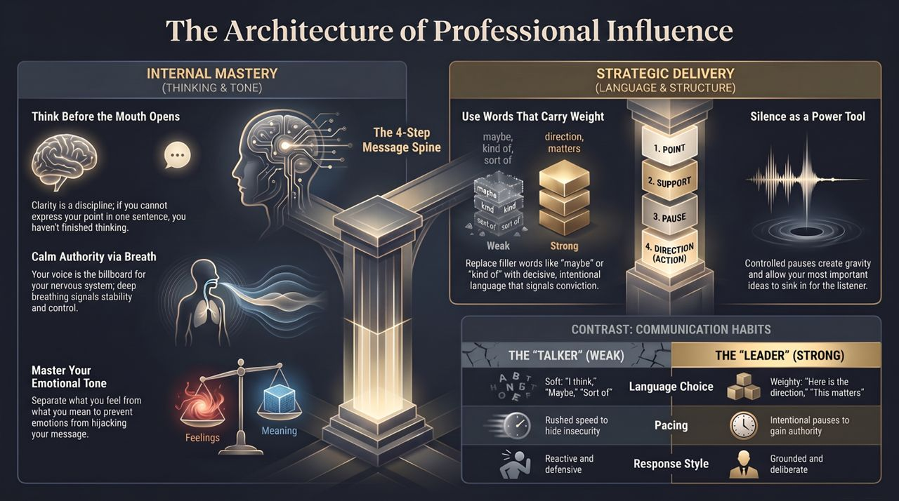
Notes:
To close this core section, let's look at The Influence Diagnostic Matrix. You can use this operational tool to troubleshoot communication challenges in real-time:
If the audience is confused or lost in details: Add Structure immediately. Lead with the main Point and cut out technical fluff.
If stakeholders agree but take no action: Provide Clear Direction. Break the immediate next step down into a small, friction-free action.
If the room becomes tense or defensive: Ground Your Tone. Lower your pitch, slow your cadence, and introduce deliberate pauses.
If listeners are skeptical or disengaged: Increase Precision. Eliminate filler crutches, present exact data, and openly state what you don't know.
How to Think, Speak, and Influence Like a Pro | Best Audiobooks
https://www.youtube.com/watch?v=EScIzEExWWE

